Slide 1
Digital Mapping of the Historical Landscape of Baltic Germans Using Named-Entity Recognition (NER) and geographical mapping
Project by Anna Baryshnikova
Master of Arts
University Erlangen-Nuremberg
Date: 15.10.2024

Slide 2
Overview of the Project
Examining the historical landscape of the Baltic Germans using digital tools.
Two key components: Textual Analysis with NER and Geographical Mapping
Objective: Creating a digital map highlighting significant locations from the “Baltische Briefe”newspaper.

Slide 3
The Baltic Germans and the “Baltische Briefe”
The Baltic Germans were a German-speaking ethnic group in the Baltic region.
The “Baltische Briefe” was a significant newspaper documenting their history and culture.
Focus on examining the locations and patterns mentioned in the newspaper.

Slide 4
Key Research Questions
How can automated geographic analysis be applied to historical texts like the “Baltische Briefe”?
What specific places are covered in the newspaper, and what is their significance?
How does this geographical information relate to the Baltic Germans' cultural and historical identity?

Slide 5
Data Collection: “Baltische Briefe”
Key editions of “Baltische Briefe”: 1949, 1950, 1988, 1991, 2004.
Access to editions at the Bavarian State Library in Munich and at the Berlin State Library.
These key years mark significant cultural and historical events for the Baltic Germans.

Slide 6
Methodology Overview
OCR (ABBYY FineReader): Used to digitize the “Baltische Briefe”for analysis.
NameTag3: Applied for NER to identify people, locations, and events.
SpaCy library: Entity disambiguation and linking
Annotated corpus: Developed using the UDPipe pipeline for tokenization, tagging, lemmatization, and parsing.
Geographical entities: Extracted and integrated into a spatial framework.

Slide 7
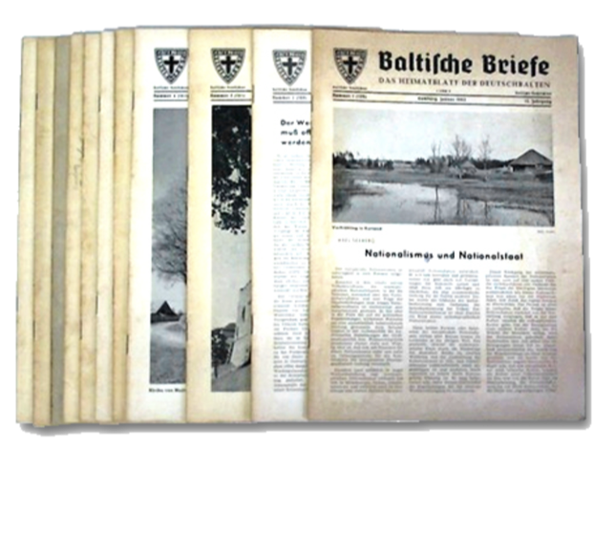
Preprocessing the Text Data
Cleaned text by removing irrelevant elements (headers, footers, etc.).
Word files were processed to XML files.

Slide 8
Named-Entity Recognition Tools: NameTag3 and SpaCy
NameTag3 is used for recognizing named entities like locations.
Entity disambiguation and linking: Done via Wikidata and SpaCy with Entity-Fishing to resolve geographical ambiguities.
Pre-trained models for German are used for extracting place names.

Slide 9
The NER Pipeline
Tokenization, Part-of-Speech tagging, and Named-Entity Recognition.
Extraction of place names (GPE – Geopolitical Entities).
Example output: list of cities, towns, regions.

Slide 10
Sample Output from NER
Example: Locations extracted from a Baltische Briefe article.
Demonstrates successful extraction of geopolitical entities like Riga and Lüneburg.

Slide 11
Challenges with Historical Place Names
Some historical place names differ from modern equivalents (Ritterstraße - Rüütli, Dorpat/Jurjew/Tartu)
Standardization of names using historical gazetteers and modern maps.

Slide 12
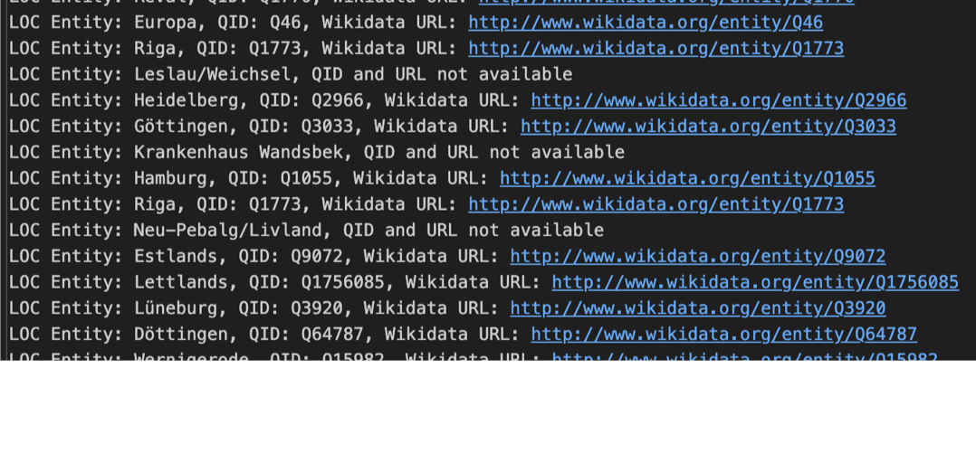
Geocoding Locations
Process of converting place names into geographic coordinates (latitude, longitude).
Geocoding was performed by accessing coordinates via Wikidata.

Slide 13
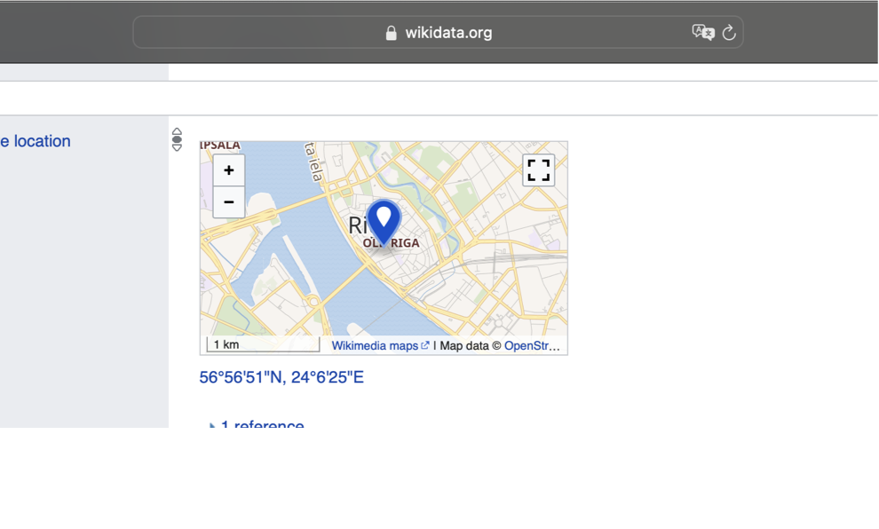
Geocoding Locations
Process of converting place names into geographic coordinates (latitude, longitude).
Geocoding was performed by accessing coordinates via Wikidata.

Slide 14
Setting up the Map
Create map layers for different sets of locations.
Use base maps (e.g., OpenStreetMap, historical maps).
Customize markers for different types of locations.

Slide 15
Conclusion and Future Work
Successfully applied digital tools like OCR, NER, and geographical mapping to analyze “Baltische Briefe”.
Visualized significant historical locations of Baltic Germans.
Gained insights into cultural identity through geographical analysis.
Extend analysis to other historical documents or time periods.
Expand the geographical scope and add layers like demographic or economic data.
Further enhance the digital map with additional datasets.

Slide 16
Thank you for your attention!

